Slide 1

FACE DETECTION USING MACHINE LEARNING
Presented By –
Kishkind Ghildial – CSE042
Navya Sinha – CSE093
Payal – CSE062

Slide 2
Introduction
Object detection is a computer technology related to computer vision and image processing that deals with detecting instances of semantic objects of a certain class (such as humans, buildings, or cars) in digital images and videos. Well-researched domains of object detection include face detection and pedestrian detection. Object detection has applications in many areas of computer vision, including image retrieval and video surveillance.
Face detection is an essential application of visual object detection, and it is one of the main components of face analysis and understanding with face localization and face recognition. Automatic face detection is a complex problem which consists in detecting one or many faces in an image. Faces are non-rigid objects. Face appearance may vary between two different persons but also between two photographs of the same person, depending on the lightning conditions, the emotional state of the subject and pose. That is why so many methods have been developed during last few years. Face Detection is a part of the computational image research field.

Slide 3
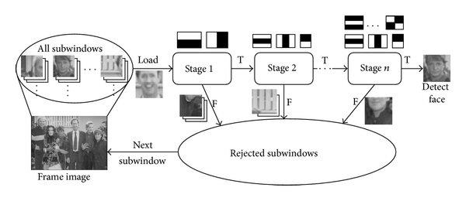
Algorithm
Haar Cascade Classifier
It is a machine learning based approach where a cascade function is trained from a lot of positive (images with face) and negative images (images without face). The algorithm is proposed by Paul Viola and Michael Jones.
The algorithm has four stages:
Haar Feature Selection
Creating an Integral Image
Adaboost
Cascading Classifiers

Slide 4
Code
import cv2
cascade_classifier = cv2.CascadeClassifier('haarcascades/haarcascade_eye.xml')
cap = cv2.VideoCapture(0)
while True:
# Capture frame-by-frame
ret, frame = cap.read()
# Our operations on the frame come here
gray = cv2.cvtColor(frame, 0)
detections =
cascade_classifier.detectMultiScale(gray,scaleFactor=1.3,minNeighbors=5)

Slide 5
if(len(detections) > 0):
(x,y,w,h) = detections[0]
frame = cv2.rectangle(frame,(x,y),(x+w,y+h),(255,0,0),2)
# for (x,y,w,h) in detections:
# frame = cv2.rectangle(frame,(x,y),(x+w,y+h),(255,0,0),2)
# Display the resulting frame
cv2.imshow('frame',frame)
if cv2.waitKey(1) & 0xFF == ord('q’):
break
# When everything done, release the capture
cap.release()
cv2.destroyAllWindows()

Slide 6
Line 1-3: Initialize the cascades for detecting faces, eyes, and smile using the OpenCV CascadeClassifier() function by passing the XML file as an argument.
Line 4: Initialize the webcam feed.
Line 6: Next, initialize a while loop that runs indefinitely or until all the frames are iterated through. The code enclosed inside is executed for each frame that comes from the webcam. Loop can also be broken if the user presses the ‘escape’ key (Line 23-25).
Line 7-9: Use the ‘read ()’ function to fetch consecutive frames from the webcam feed. This is pre-processed by converting it to grayscale (using cv2.cvtColor) and then sent to our face classifier object for classification using the ‘detectMultiScale’ function which returns the coordinates(x,y,w,h) of faces that are detected by the classifier.

Slide 7
Line 11: Begin a for loop that loops through all the detected faces (and use the ‘cv2rectangle’ function to put a bounding box around it). For the convenience of detection of eyes and smiles (both smaller in size), we define a sub-area in the grayscale-video frame (which is thearea that was returned to us by the face cascade). This can be done only because eyes or a smile will only be detected inside a face. (Line 13-14)
Line 16-21: Pass the sub-area defined in the previous step to the ‘eye’ and ‘smile’ cascades so that an array of coordinates of detected eyes and smiles is returned. Next, initialize ‘for’ loops for each of these arrays (Line 18 & 20) and put bounding boxes around each of the detected objects (Line 21).
Line 27: Finally, release the webcam video feed loaded into memory.
Line 28: Close all windows (If any are left open and running).

Slide 8
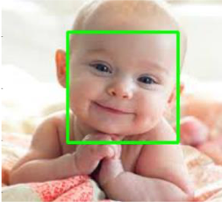
Output
The output of running the following code will be as follows.

Slide 9
Conclusion
Face detection systems are currently associated with many top technological companies and industries making the work of face recognition easier. The use of python programming and OpenCV makes it an easier and handy tool or system which can be made by anyone according to their requirement. The proposed system discussed in this project will be helpful for many as it is user friendly and a cost-efficient system. Hence using python and OpenCV the face detection system can be designed for various purposes.

Slide 10

Thank You

